Slide 1





Did you know ?
Spotify relies on Google Cloud Storage to handle and store the massive amount of audio and user data.
Notes:
Audio & user data required to stream millions of songs daily and provide personalized recommendations to users in Spotify is stored in Google Cloud Storage..
Snap Inc. (Snapchat) - Snapchat uses Google Cloud Storage to manage its rapidly growing multimedia content. Google Cloud's scalable storage solution helps Snapchat store user images and videos efficiently, supporting features like Stories and Memories.
Twitter - Twitter leverages Google Cloud Storage to archive and analyze massive datasets. This setup aids Twitter in managing its social media data effectively and provides insights for improving user experience and content recommendations.
Airbnb - Airbnb utilizes Google Cloud Storage as part of its data infrastructure to manage images, customer data, and property listings, enabling a seamless booking and hosting experience.
PayPal - PayPal uses Google Cloud Storage to process and secure financial transaction data and customer records, ensuring data reliability, availability, and compliance.
These companies benefit from Google Cloud Storage’s scalability, high availability, security, and integration with other Google Cloud services, helping them manage large-scale data operations efficiently.

Slide 2





Working with Cloud Storage APIs
Google Cloud Skills for Africa
2024
Samuel Macharia - Cloud Engineer
@engeniusam
Notes:
I am Cloud Engineer and a community advocate, last yr GDSC Lead at UEAB and currently a mentor in the Google Cloud Skills for Africa 2024. I do enjoy inspiring others through what I learn in tech with todays focus on the Google Cloud Platform.

Slide 3

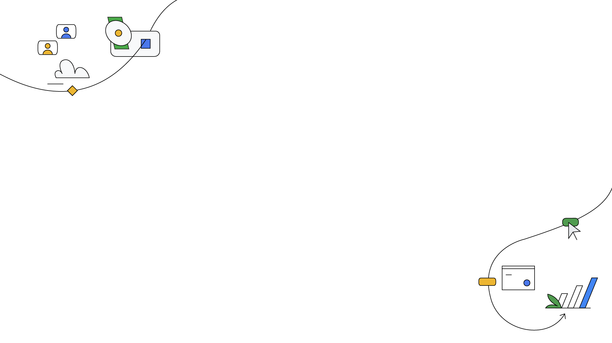
Key Terms Breakdown
API (Application Programming Interface? A set of protocols and tools for building software and applications
CLI (Command-Line Interface): A text-based interface that allows users to interact with software by typing commands.
API Explorer: An online tool provided by Google to test and interact with Google Cloud APIs.
SDK (Software Development Kit): A collection of software tools and libraries that developers use to create applications for specific platforms.
Buckets: Containers in Google Cloud Storage used to store data objects (files).
Notes:
Key Points:
API (Application Programming Interface):
A set of protocols and tools for building software and applications. It allows different software components to communicate with each other, enabling interaction with Google Cloud services.
CLI (Command-Line Interface):
A text-based interface that allows users to interact with software by typing commands. In Google Cloud, the gsutil CLI lets users manage Cloud Storage directly from the terminal.
API Explorer:
An online tool provided by Google to test and interact with Google Cloud APIs. It allows users to make API requests and see responses without needing additional setup.
SDK (Software Development Kit):
A collection of software tools and libraries that developers use to create applications for specific platforms. Google Cloud SDK includes command-line tools like gcloud and gsutil for managing Google Cloud resources.
Buckets:
Containers in Google Cloud Storage used to store data objects (files). Buckets provide scalable, highly durable storage for files and are essential for organizing and accessing data.
Footnote:
These key terms represent essential concepts for managing cloud resources. APIs and SDKs provide programmability, the CLI offers command-based control, API Explorer simplifies testing, and buckets serve as primary storage containers, enabling a structured approach to data management.

Slide 4

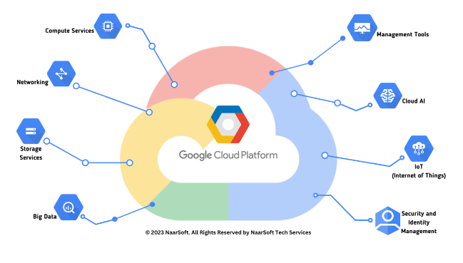
Google Cloud Skill Badge Achievement
Google Cloud Skills for Africa
Completing the course grants a digital skill badge for Cloud Storage API proficiency.
Shareable badge for professional networking platforms like LinkedIn.
Demonstrates competency with Google Cloud Storage and APIs.
2024
Notes:
Skill badges issued by Google Cloud recognize technical expertise and proficiency in specific cloud technologies. Completing this course and earning the badge can boost credibility and enhance career prospects for cloud enthusiasts and professionals.
Whether you are interacting with Kubernetes (GKE), Firebase, Cloud Run, App Engine - the badge you earn from these labs comes in handy to that recruiter who is interviewing you for that cloud role.

Slide 5
Let’s go
Use APIs to work with cloud storage:tinyurl.com/GCP-Cloud-storage-api

Slide 6


Slide 7

Let’s Be Friends :)
@jumason_felix

